Slide 1

Development of machine learning models to process Electronic Health Records – Explainable Models
Week 3 Meeting, 17/10/2021

Slide 2





WhAT I have done
Watched the week 2 videos from module 1 and some in module 2

Slide 3
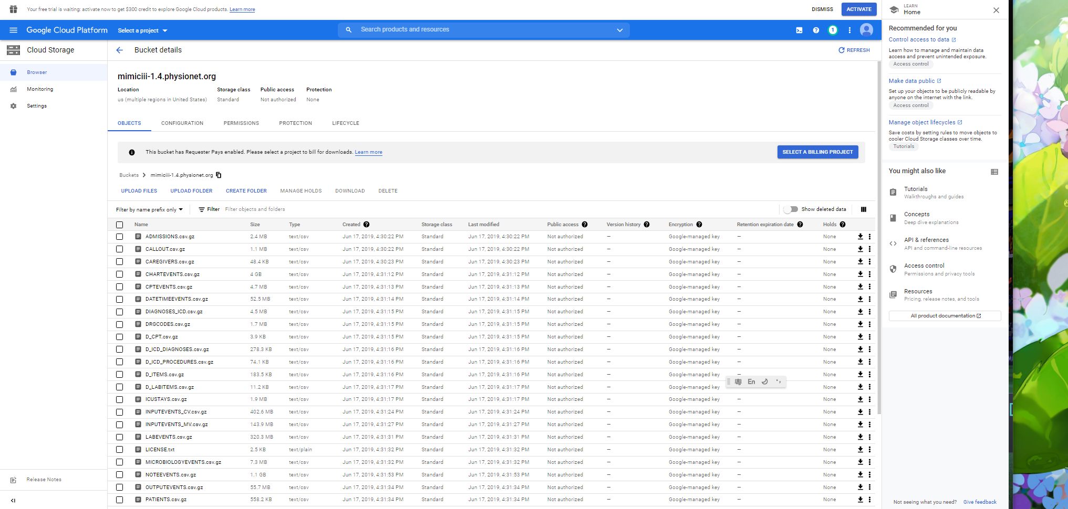
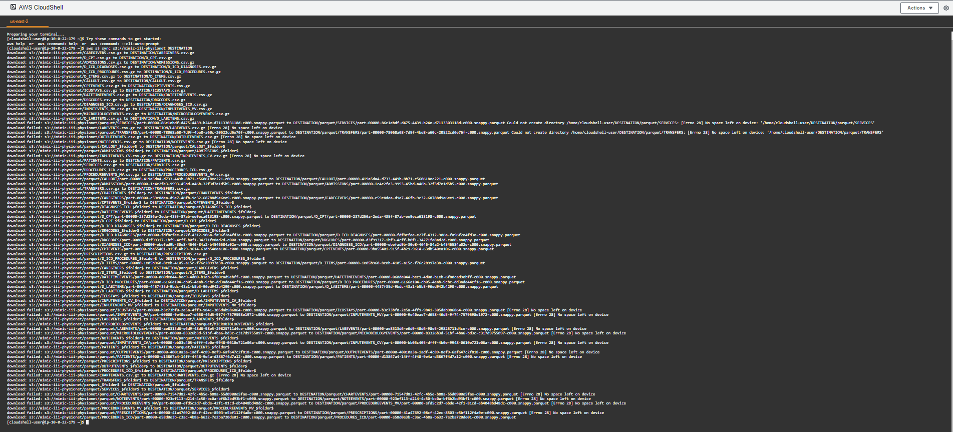


What I have done
Tried accessing the data on Google Cloud and AWS
Google
AWS
Not enough cloud space error?

Slide 4
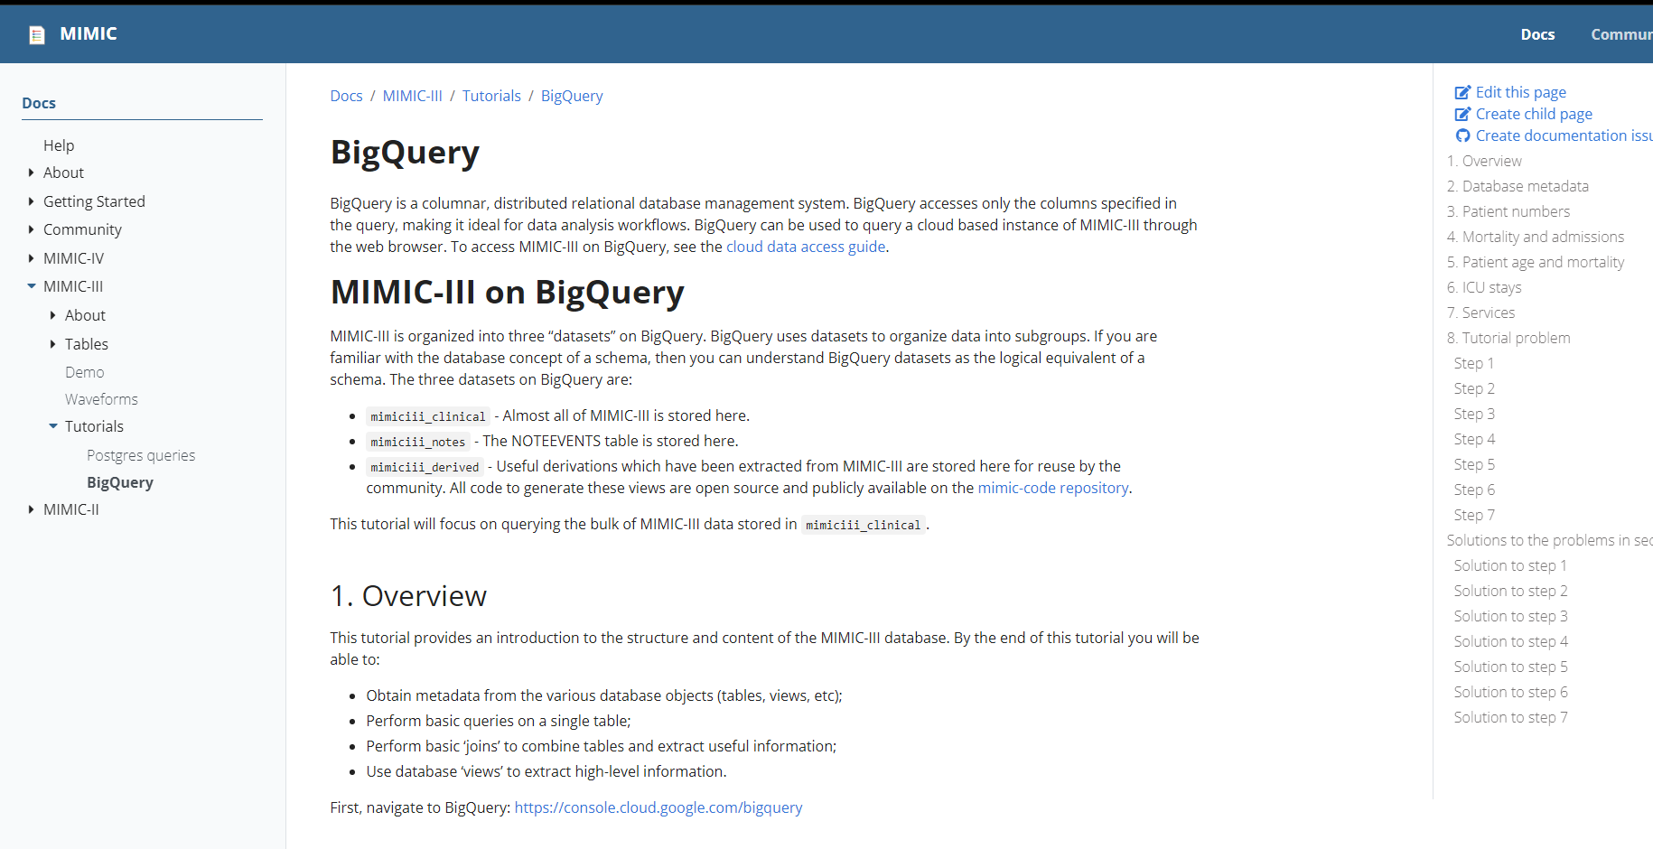
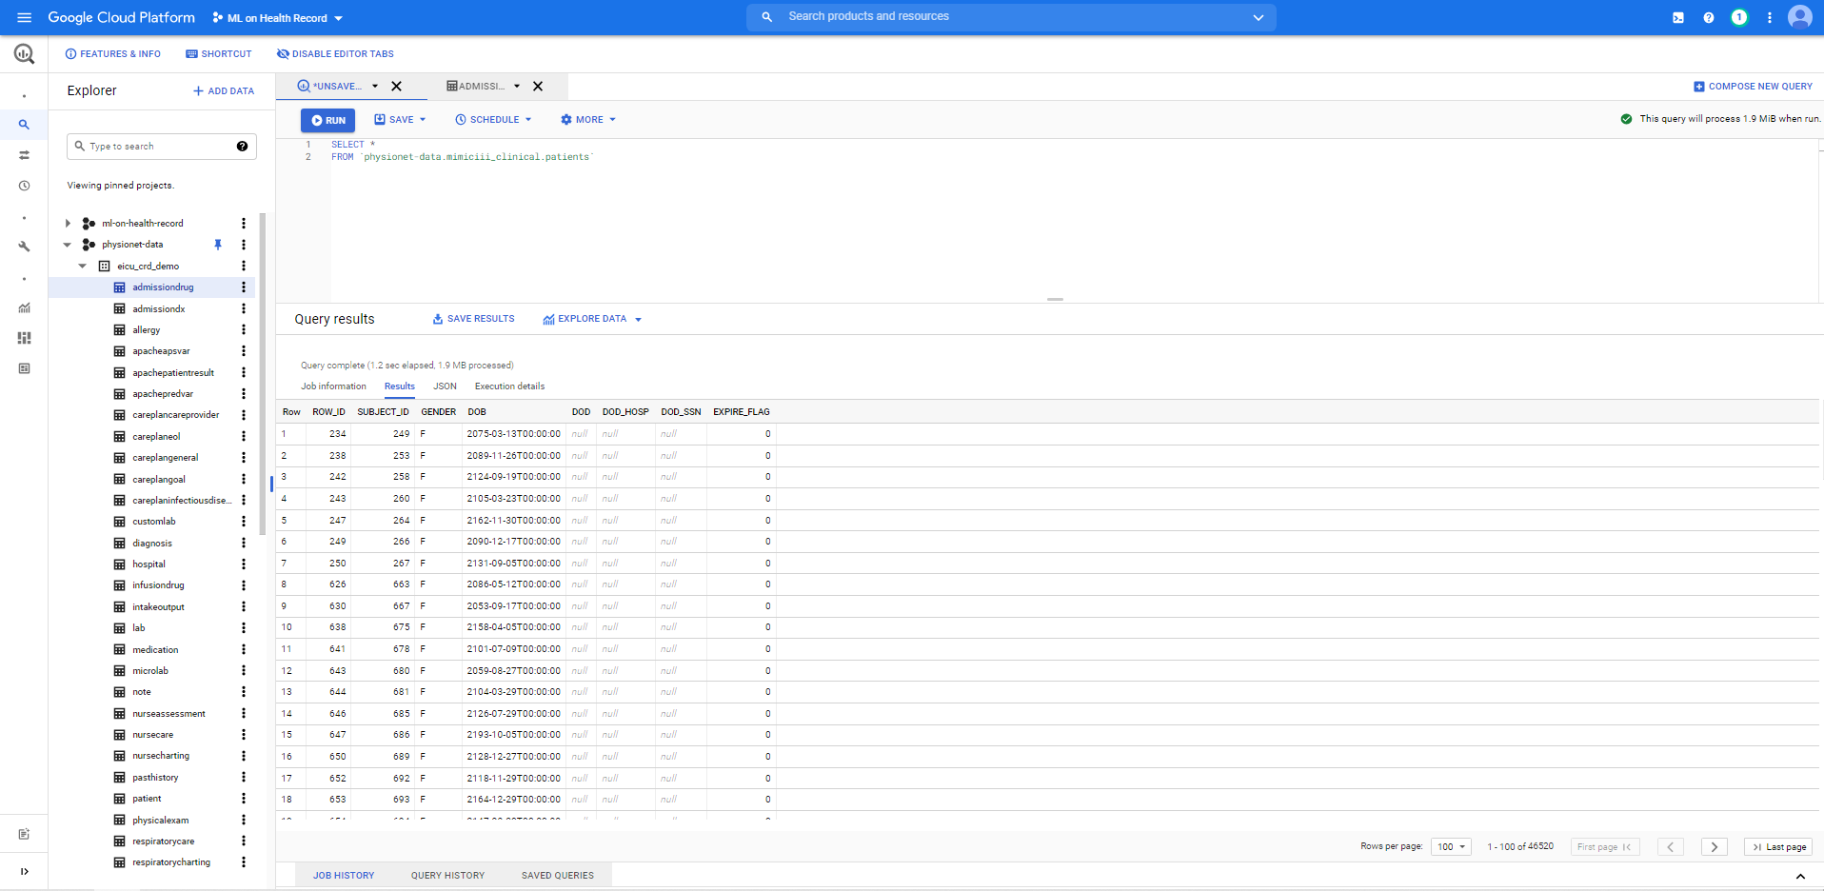
What I have done
Got access to the data through Google Big query
Checked out and followed the Tutorial to familiarize myself with the data

Slide 5
Questions
How will I carry out ML on the data? Convert the data into an array and process it in a .pynib file?
Will this be covered in later weeks?
How do we export the query results and turn them into data used in machine learning?
Ex. Extracting all the charted events for each patient into a numpy array?
What will the end product be like?
An application that takes in a health record then processes it to predict mortality rate?
A report on the findings of what affects the mortality rate the most?
Is it flexible?

